Slide 1
Software Engineering Presentation | Slither

Slide 2
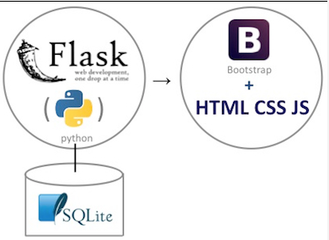


Web application Architecture
Technologies:
Flask | WSGI (Web Server Gateway Interface) web application framework
MongoDB |cross-platform document-oriented database program. Classified as a NoSQL database program, MongoDB uses JSON-like documents with schema
PhaserIO | desktop and mobile HTML5 game framework

Slide 3
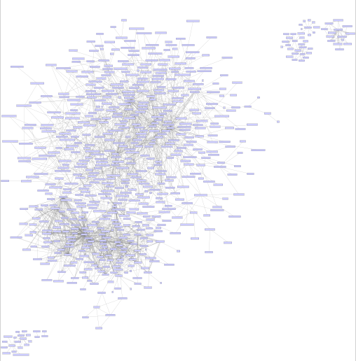
Java Module Dependencies
Webpack
Webpack/…/webpack.js
Mongodb
mongodb/…/collection.js
mongodb/…/utils.js
mongodb/…/index.js
Ts-loader
JQuery
Bootstrap
Notes:
webpack.config.js: used to direct webpack to enter through ./index.ts, load all .ts and .tsx files through the ts-loader, and output a bundle.js file in our current directory.

Slide 4
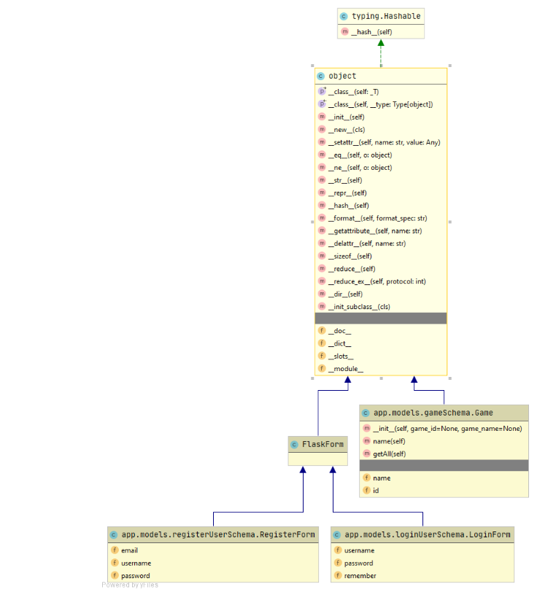
Python Class Diagram (Flask)
Inputs:
User Login (name, password) with reCaptcha
Session tokens
User Options (difficulty, snakeskin, background)
Outputs
Successful login
Ability for game play
Notes:
webpack.config.js: used to direct webpack to enter through ./index.ts, load all .ts and .tsx files through the ts-loader, and output a bundle.js file in our current directory.

Slide 5
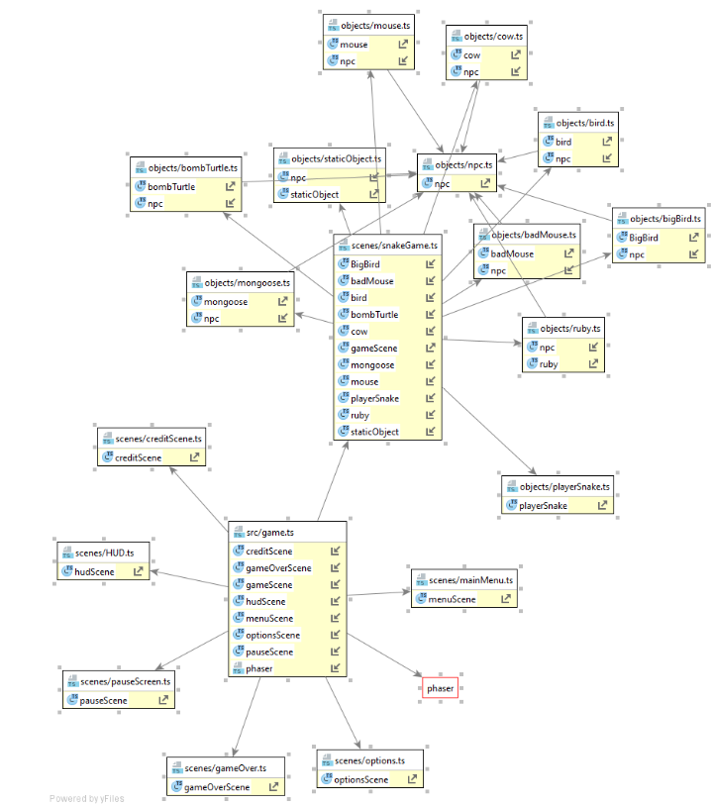
Typescript Class Diagram (Phaser)
Webpack
Webpack/…/webpack.js
Mongodb
mongodb/…/collection.js
mongodb/…/utils.js
mongodb/…/index.js
Ts-loader
JQuery
Bootstrap
Notes:
webpack.config.js: used to direct webpack to enter through ./index.ts, load all .ts and .tsx files through the ts-loader, and output a bundle.js file in our current directory.

Slide 6
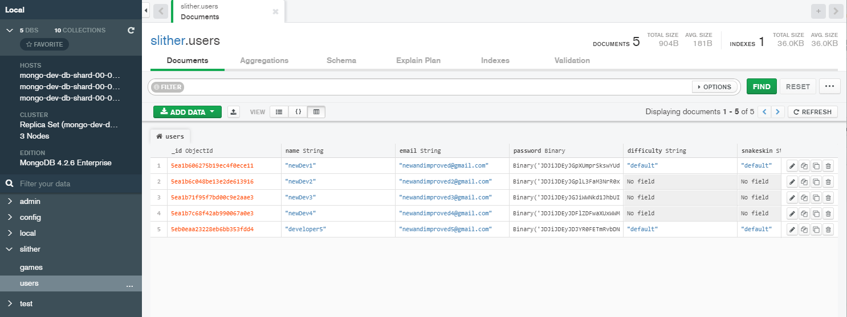
MongoDB Database Tables
Collections
Users
Games
Notes:
webpack.config.js: used to direct webpack to enter through ./index.ts, load all .ts and .tsx files through the ts-loader, and output a bundle.js file in our current directory.

Slide 7
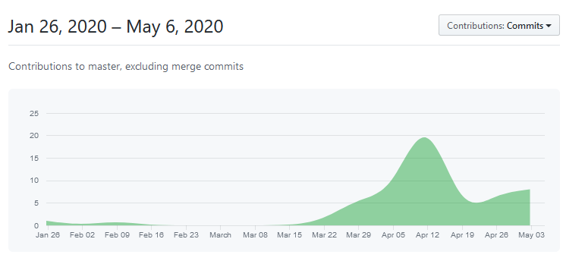
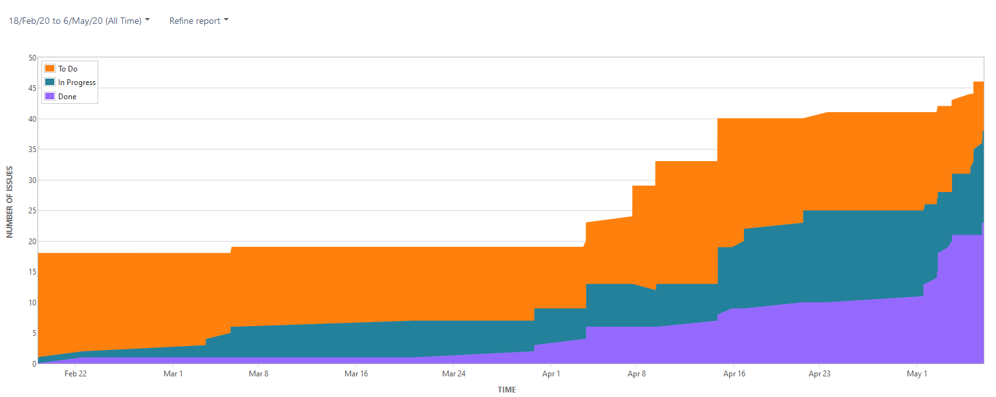
Agile Software Development
GITHUB | Commits
JIRA | Cumulative Flow Diagram
Notes:
CFD: hows the statuses of issues over time. This helps you identify potential bottlenecks that need to be investigated.

Slide 8
FLASK STATE DIAGRAM
User navigates to website
User leaves website
Registration failed
Register Page
User quits game
Home Page - Not Logged in
User already registered
Login failed
Slither Game
Login Page
Homepage – Logged in
User Options Appended
Search Page Available Titles
User selects game [search selection]
User selects game [gallery selection]

